Slide 1
MEC101
Mechanical Sciences-I
Chapter 4: Torsion

Slide 2
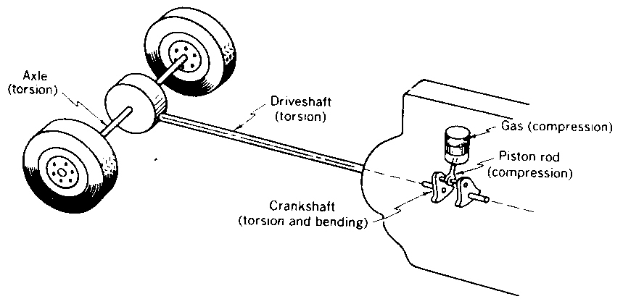
Torsion

Slide 3
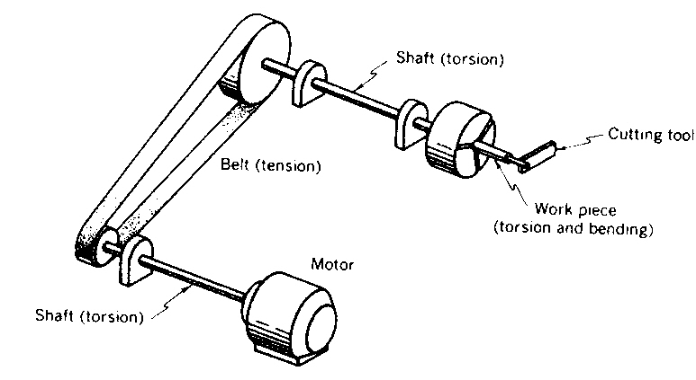
Torsion...

Slide 4
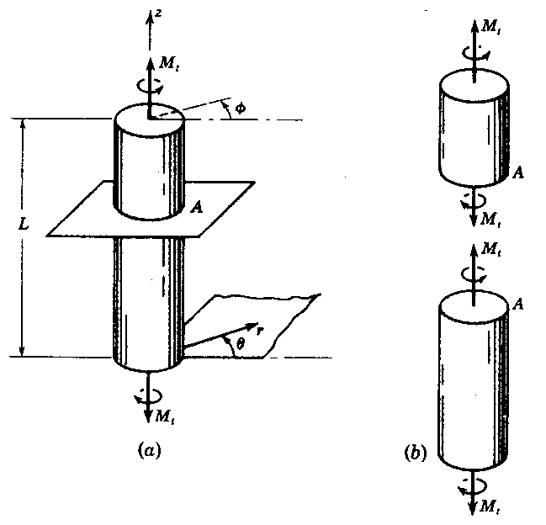
Torsion...

Slide 5
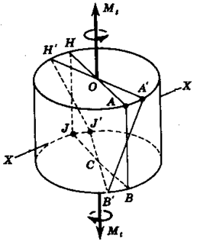
Torsion...
ε_{rr}, ε_{θθ}, ε_{zz} are zero!
γ_{rθ}, γ_{rz} are also zero.
Only γ_{θz} is non-zero.
Therefore, only τ_{θz} is non-zero.

Slide 6
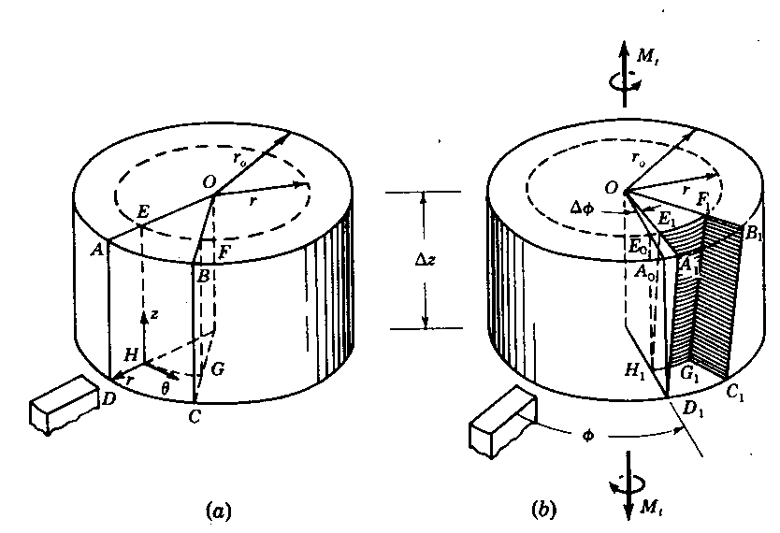
Torsional Strain
γ_{θz}= lim (E_{o}E₁/E_{o}H₁) = lim rΔΦ/Δz
= rdΦ/dz
Δz→ 0
Δz→ 0

Slide 7
Torsional Stress
γ_{θz}= rdΦ/dz
Therefore, τ_{θz} = GrdΦ/dz

Slide 8
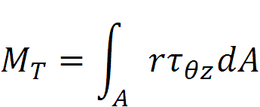
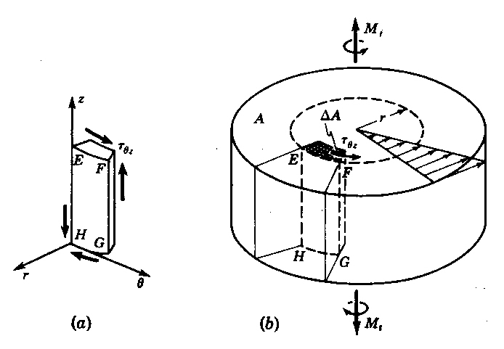
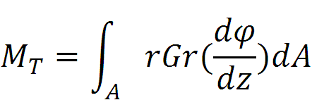
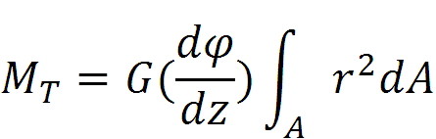
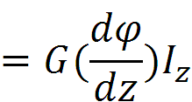
Equilibrium
Polar moment of inertia

Slide 9
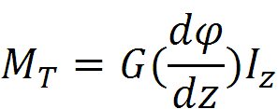
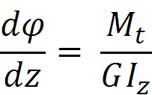
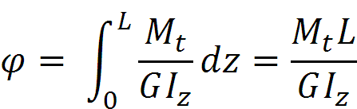
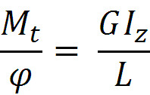
Equilibrium...
τ_{θz} = GrdΦ/dz
= M_{t}r/I_{z}

Slide 10
Shear Stress Distribution
τ_{θz} = M_{t}r/I_{z}

Slide 11
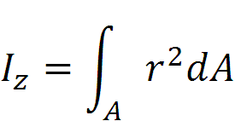
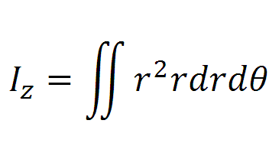
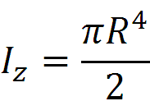
Solid Shaft
r varies from 0 to R, and θ varies from 0 to 2π

Slide 12

Hollow Shaft
By geometry: γ_{θz}= rdΦ/dz
Therefore, τ_{θz} = GrdΦ/dz
r varies from R₁ to R₂, and θ varies from 0 to 2π

Slide 13
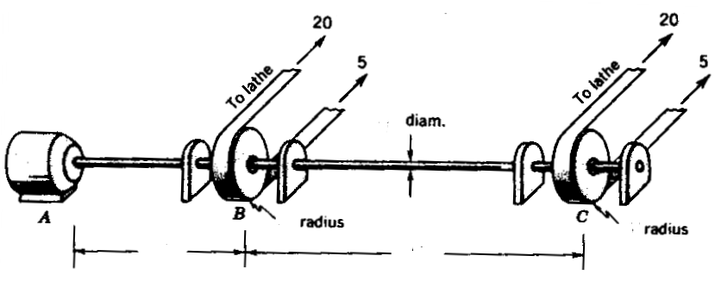
A Example
kN
kN
kN
kN
0.01 m
0.15
0.15
0.60
1.20
+4.5 Nm
-2.25 kNm
-2.25 kNm
●
●
●
z
TMD
ΔΦ₁
ΔΦ₂
ΔΦ = ΔΦ₁ + ΔΦ₂

Slide 14



A Example
TMD
ΔΦ₁
ΔΦ₂
= 9.82×10⁻¹⁰ m⁴
(4.5
Similarly Φ₂. Then Φ = Φ₁ + Φ₂

Slide 15
Another Example
M₁
M_{o}
M₂
TMD
Equilibrium Condition: - M₁ + M_{o} – M₂ = 0
Geometric Condition: Φ₁ +Φ₂ = 0

Slide 16


Torque Gauge
τ_{o}
Z
θ
τ
τ_{o}
●
σ₂= -τ_{o}
σ₁= τ_{o}
σ
●
τ_{o}
ε₁ = (1/E)(τ_{o} + ν τ_{o})

Slide 17
Combined Stresses
θ
Z
τ
●
σ
●

